Slide 1
CLASSROOM RULES
Be on time
Be interactive
100% or Nothing
Do all Daily Challenges

Slide 2
REVIEW:
GRAMMAR + VOCABULARY

Slide 3
REVIEW: LISTENING
What’s your new apartment like?
It’s comfortable, but it’s pretty small. It’s only got one room.
How many rooms does it have?
It’s got two bedrooms, a living room, and a huge kitchen and bathroom.
Does the kitchen have everything you need?
We don’t have much furniture yet.
I’ve got a dinner table, but I still need a sofa.
I got a really cheap used TV the other day.
I need a TV, but I’m waiting for the new models.
However, I still haven’t bought a dinner table.

Slide 4
REVIEW: SPEAKING
1. What is your house like? How many rooms are there in your house?
2. What is your favorite room in your house? Why?
3. Can you describe your living room/ bedroom/ kitchen?

Slide 5
Lesson 12: Verbs and tenses 1

Slide 6
Objectives
  What is verb?
1
  Present simple tense
2
  Present continuous
3

Slide 7


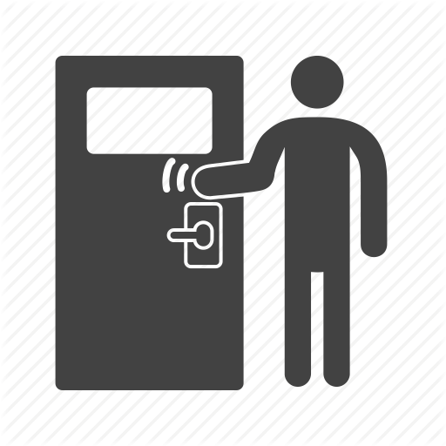

What is verb?
Most verbs are action words.
They tell you what people, animals or things are doing.
read
sing
climb
knock

Slide 8
Find the VERBS in the following sentences.
1. The children go to school by bus.
2. I usually listen to rock music.
3. My mom always cook dinner for us.
4. My father does gardening in our backyard.
5. Mr. Thomas teaches us science.
6. We often go shopping on Sundays.

Slide 9
REVIEW: Common verb phrases
Have
Go
Do
Make
Come
Take
Bring
Get

Slide 10
GRAMMAR

Slide 11
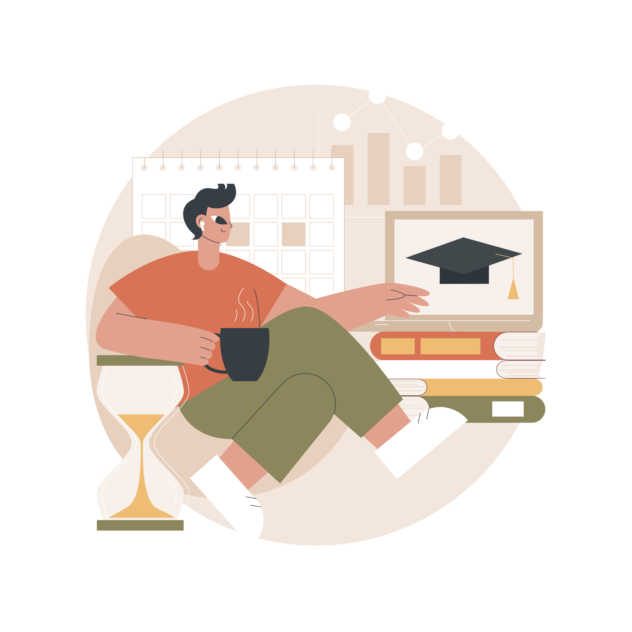
PRESENT SIMPLE TENSE

Slide 12
Usage
Example
Express the truth
The sun rises in the East.
Habits
My father plays badminton every Tuesday.
Express timetable events
Our train leaves at 9 am.

Slide 13



Present Simple
TO BE
VERB
S + am/is/are + N/adj
S + verb (s/es) + O
I am a student.
Mai plays sports every day.
S + am/is/are + not + N/adj
S + do/does + not + verb + O
I am not a student.
Mai doesn’t play sports every day.
Am/Is/Are + S + N/adj?
Do/Does + S + verb + O?
Am I a student?
Does Mai play sports every day?

Slide 14
Helpful hints
The present simple tense is often used with:
1. Phrases
Every day/month/week/year
Each Monday/ month/week/year
Once/twice a week/month
Three times a week/month
2. Adverbs of Frequency
Always
Usually
Often
etc

Slide 15
Always
Adverbs of Frequency
/ˈɔːlweɪz/
Usually
Often
/ˈjuːʒəli/
Sometimes
/ˈɒfn/
Rarely
/ˈsʌmtaɪmz /
Never
/ˈreəli/
/ˈnevə/

Slide 16
Frequency
Once
Twice
Three times
Four times
Day
Week
Month
Year
a

Slide 17

A day in the life of a student
I ____ (be) a student. Every day, I wake up at 7am and have breakfast. My mom usually ______ (make) breakfast for me, but sometimes I just grab a loaf of bread from the bakery near my house. I go to school by bike almost every day. Just once or twice a week, my dad ____ (drive) me to school. At 5pm, after class, my friends and I often _____ (hang out) until about 6pm. Then, I go home, take a shower, and have dinner. I usually ____ (do) my homework until 9pm, and after that, I ____ (play) video games for a little while. I always go to bed before 11pm, and that’s a typical day for me!

Slide 18
A day in the life of a student
I am a student. Every day, I wake up at 7am and have breakfast. My mom usually makes breakfast for me, but sometimes I just grab a loaf of bread from the bakery near my house. I go to school by bike almost every day. Just once or twice a week, my dad drives me to school. At 5pm, after class, my friends and I often hang out until about 6pm. Then, I go home, take a shower, and have dinner. I usually do my homework until 9pm, and after that, I play video games for a little while. I always go to bed before 11pm, and that’s a typical day for me!

Slide 19
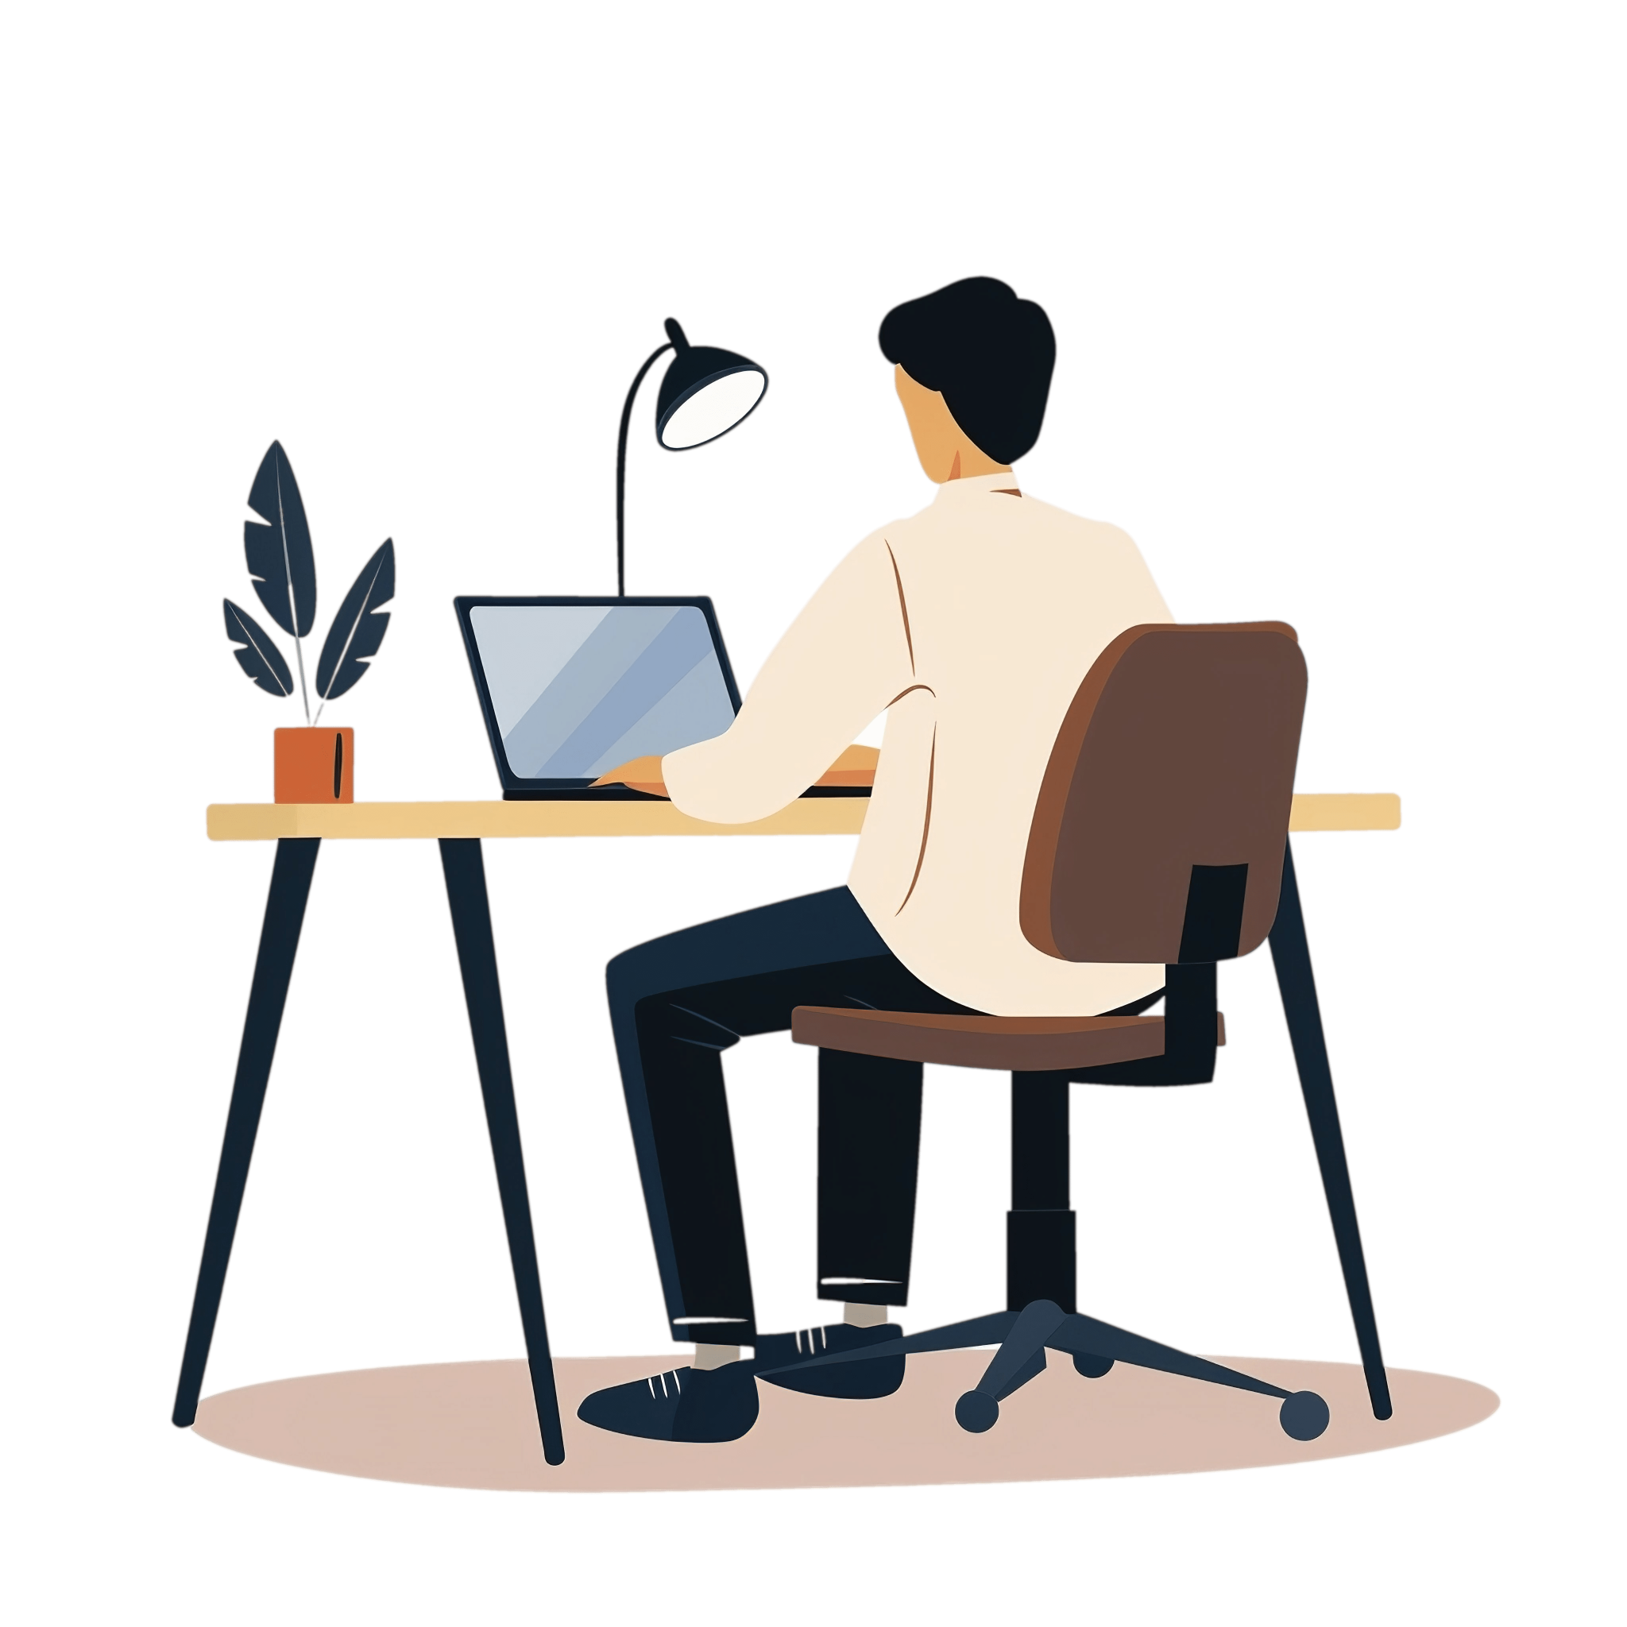
PRESENT CONTINUOUS TENSE

Slide 20


Present continuous tense
S + am/is/are + V-ing + …
He is playing football.
S + am/is/are + not + V-ing + …
He isn’t playing football.
Am/Is/Are + S + V-ing + …
Is he playing football?

Slide 21
Usage
Example
Actions happening now
Jim is watching TV at the moment.
Describe an action that is taking place now but not at the exact moment of speech
Jane is working in London.
Describe a temporary situation
I’m staying with a friend for a few days.
Describe an event in the future
We are having a barbecue tonight.
Describe an annoying habit (always)
She is always coming late.

Slide 22
Helpful hints
The present continuous tense is often used with:
1. Words
now
today
tonight
2. Phrases
At the moment
Right now
This week/ month,etc.

Slide 23
Present simple - Present continuous
Present Simple
Present Continuous
Describe a truth
He comes from Vietnam.
Express present habits
He often stays up late.
Express timetable events
The class starts at 8 am.
Describe an action happening now
She is reading the project now.
Express an annoying habit (+always)
You are always staying up late!
Describe an event in the future
She is getting married next Tuesday.

Slide 24
Complete these sentences with the present simple or the present continuous form of the verb in brackets.
Plan a trip with me
We ____________(1 - go) on a holiday tomorrow. The train ____________ (2 - start) at 9am, so we ____________ (3 - come) to the train station at 8.45am. Now, we ____________ (4 - pack) up our suitcases; I often ____________ (5 - bring) a lot of clothes, but this time I ______________ (6 - not/bring) much clothes because the weather there ________ (7 - be) very hot. My mom ____________ (8 - set) the alarm for 7 a.m. tomorrow - the bus from our house to the airport ____________ (9 - leave) at 7:30 a.m. But I _________ (10 - be) worried because my father _______________ (11 - always /get) up late, so I ____________ (12 - wake) him up early tomorrow. And my mom usually ____________ (13 - make) breakfast for us, yet we ____________ (14 - buy) some sandwiches for breakfast tomorrow. This ________ (15 - be) our first holiday together, so I ____________ (16 - look) forward to it.
are going
starts
are coming
are packing
bring
am not bringing
is
is setting
leaves
am
is always getting
am waking
makes
are buying
is
am looking

Slide 25

THANKS!

